Slide 1
Modelling and Implemention of Real-world Fraud Detection System based on Artificial Neural networks
Rakendra Thapa (rakendra.thapa@infineon.com)
Date: 19 April 2018

Slide 2
Introduction
Introduction:
The expansion of electronic commerce, together with increasing confidence of customers in electronic payment, effective Fraud Detection Systems (FDS) are increasingly becoming a critical factor.
The Fraud Detection we discuss in this paper is the process of identifying if an authorized credit card transaction belongs to the class of fraudulent or genuine transaction.
Already lot of work has been done in this field. The challenges still makes it one of the most challenging application of AI.
Focus
Modeling the Real-World Fraud Detection System (FDS).
Identify the CHALLENGES to model a Realistic FDS.
Strategies to address with these CHALLENGES and propose a model for a better FDS.

Slide 3
Introduction.
Dataset:
Public domain dataset containing information about credit card transaction with examples of fraudulent samples (http://www.ulb.ac.be/di/map/adalpozz/data/creditcard.Rdata).
31 numerical input
Time – Second elapsed between each transaction and first transaction in the dataset.
V1~V28 (Unlabeled inputs) – For confidentiality reason.
Amount – Transaction amount.
Labelled Class - Response variable
0 (Genuine Transaction)
1 (Fraudulent Transaction)
Skewed dataset with fraud representing 0.172% of all transaction (492 frauds out of 284807 transactions).
Dividing data set into 2 categories:
Train dataset : 60% of the original dataset
Test dataset: 40% of the original dataset

Slide 4
Modelling the Real-World FDS
Real Time
Near Real Time
Offline
Scoring Rules
Expert Driven
Transaction Attempt
Transaction Request
Terminal
Correct Pin?
Sufficient Balance?
Active Account?
Transaction Blocking Rules
Investigators
Data Driven
Authorized Transaction
Alerts
Data Driven Model
FDS we model
Transaction Denied
Feedback
Automatic Tools
Human Supervision
The Layers of Fraud Detection System. In this model, we focus only on the data driven part.

Slide 5
Challenges in Data Driven Fraud Detection Systems
Class Imbalance / Skewed Data : Frauds represent a small fraction of all the daily transactions. Distributions of genuine and fraud samples are not only unbalanced, but also overlapping.
Concept Drift: Fraud Distribution evolves over time because of seasonality and new attack strategies. Thus, the transaction might change their statistical properties over time. FDS strategies that are not updated or revisited frequently are often losing their predictive accuracy in the long term.
Verification Latency: The true nature (class) of the majority of transaction is typically known only several days after the transaction took place, since only few transactions are timely checked by investigators.

Slide 6
Challenges: Unbalanced/Skewed Data
Problem Statement:
Standard machine Learning algorithms that maximizes overall accuracy tend to classify all observation as majority class instances.
Minority Class (e.g. fraudulent Transactions) class of interest.
Poor accuracy on minority class (low recall).
Solutions:
We can categorize methods dealing with this problem, operating at:
Algorithmic Level – Algorithms themselves adjusted to deal with Minority class detection.
E.g. Neural Nets, SVM, Ensemble Methods.
Data Level – Unbalanced strategies used as pre-processing step to rebalance the classes before any algorithm themselves applied.
Undersampling: Downsizing Majority class by removing observations at random until the data set is balanced.
Oversampling: Upsizing minority class at random, decreasing level of class imbalance.
SMOTE : Oversamples the minority class by generating synthetic examples in the neighbourhood of observed ones. This has the effect of creating clusters around each majority observation.

Slide 7
Algorithmic Level: Neural Nets
Neural Networks have been extensively applied in Fraud Detection Systems. [1][2][3][4][5].
[3] shows that 3 layers ANN is capable of dealing with highly skewed class distributions.
Implementation:
3 layer Neural-Net:
Layer 1 (Input Layer): 30 feature Variables: V1~V28, Amount.
Layer 2: (Hidden Layer): Number of Units: 20
Layer 3: (Output Layer): Class Label: 0 (Genuine) or 1(Fraudulent).
Activation Function: Sigmoid: 1/1+exp(-z)
Gradient Learning: Backpropogation Algorithm.
Error Threshold: 0.1
Learning Rate: 0.3
Classification Threshold: 0.5.

Slide 8
Result: (3 Layer ANN)
Confusion Matrix and Statistics:
Accuracy: 0.9993855499
Classification Error Rate: 0.000614450111
Precision: 0.9113924051
Sensitivity (TPR): 0.72
Specificity (TNR) : 0.9998768939
AUC: 0.96003
 | Reference
Prediction |  | 0 | 1
 | 0 | 113709 | 56
 | 1 | 14 | 144
FN | FP | TN | TP
56 | 14 | 113709 | 144
Good Performance.
Improvement Areas:
Sensitivity (to Increase)
False Negative. (to Decrease)

Slide 9
Undersampling for Unbalanced Classification.
Undersampling: Downsizing the majority class by removing observations at random until the dataset is balanced.
Assumptions:
Testing and Training Set come from same distribution. Thus, Testing Set also has skewed data
In majority class there are many redundant observations and randomly removing some of them does not change the estimation of within class distribution.
Pros:
Speeds up learning Phase.
Cons:
Can still remove relevant data from Majority Class.
Impact: Introduced Artificial Bias (towards Minority Class).
Since the Test Data and Training Data came from same distribution, Posterior probability of the test dataset is affected due to the model studied on the undersampled data.
Thus, we need probability calibration and threshold adjustment.

Slide 10

Posterior Probability Calibration for Model Learned on Undersampled Data.
Let,
X is input variable set
Y is output class set (0, 1)
S is random binary selection variable for each of the N samples in (X, Y).
1 if the point is in (X, Y ) and
0 otherwise.
+ denote y = 1
− denote y = 0,
p(+, x) = p(y = 1, x) and p(−, x) = p(y = 0, x).
From Bayes’ rule, we can write:
p(+|x, s = 1)$=\frac{\text{p}\text{(}\text{s}\text{ = 1|+)}\text{p}\text{(+|}\text{x}\text{)}}{\text{p}\text{(}\text{s}\text{ = 1|+)}\text{p}\text{(+|}\text{x}\text{) + }\text{p}\text{(}\text{s}\text{ = 1|−)}\text{p}\text{(−|}\text{x}\text{)}}$ …… Eq 1.

Slide 11
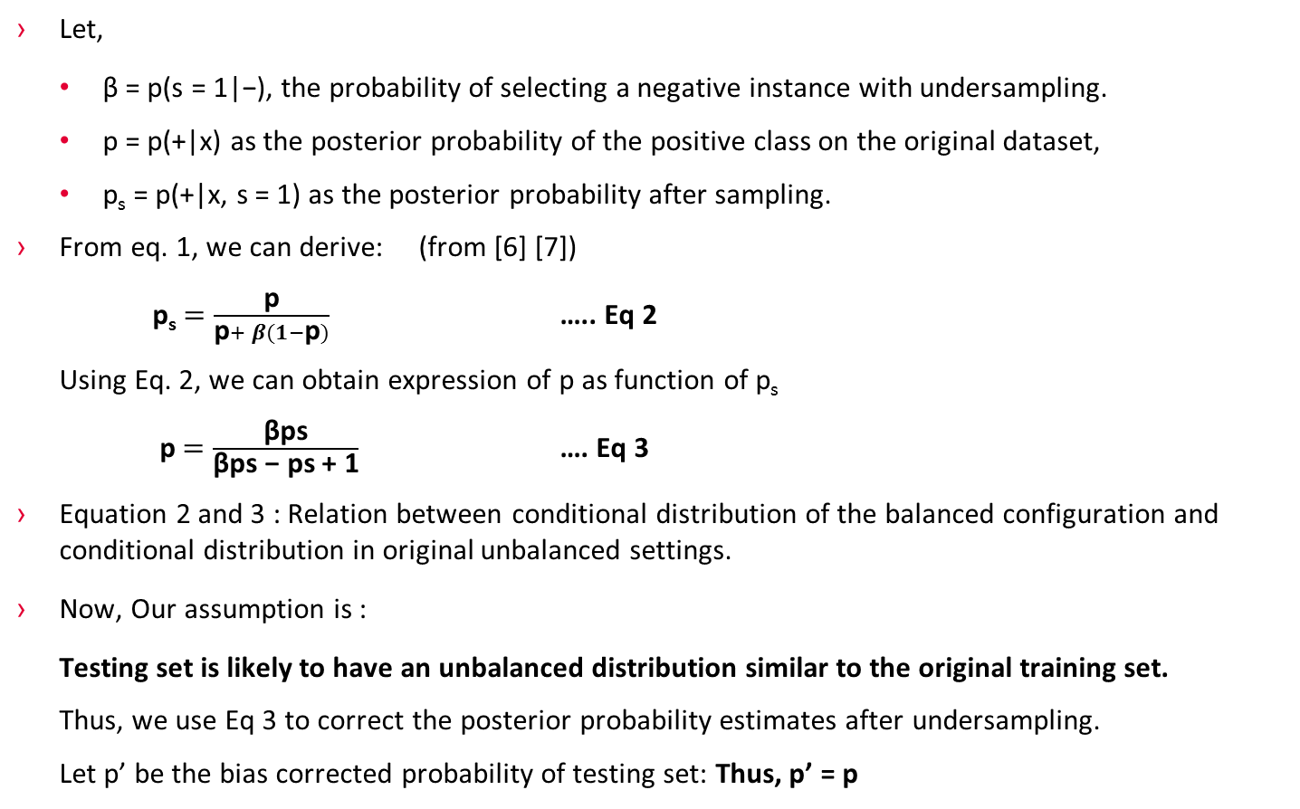
Posterior Probability Calibration for Model Learned on Undersampled Data.
Let,
β = p(s = 1|−), the probability of selecting a negative instance with undersampling.
p = p(+|x) as the posterior probability of the positive class on the original dataset,
p_{s} = p(+|x, s = 1) as the posterior probability after sampling.
From eq. 1, we can derive: (from [6] [7])
p_{s}$=\frac{\text{p}}{\text{p}+ β(1−\text{p})}$ ….. Eq 2
Using Eq. 2, we can obtain expression of p as function of p_{s}
p $=\frac{\text{β}\text{ps}}{\text{β}\text{ps}\text{ − }\text{ps}\text{ + 1}}$ …. Eq 3
Equation 2 and 3 : Relation between conditional distribution of the balanced configuration and conditional distribution in original unbalanced settings.
Now, Our assumption is :
Testing set is likely to have an unbalanced distribution similar to the original training set.
Thus, we use Eq 3 to correct the posterior probability estimates after undersampling.
Let p’ be the bias corrected probability of testing set: Thus, p’ = p

Slide 12
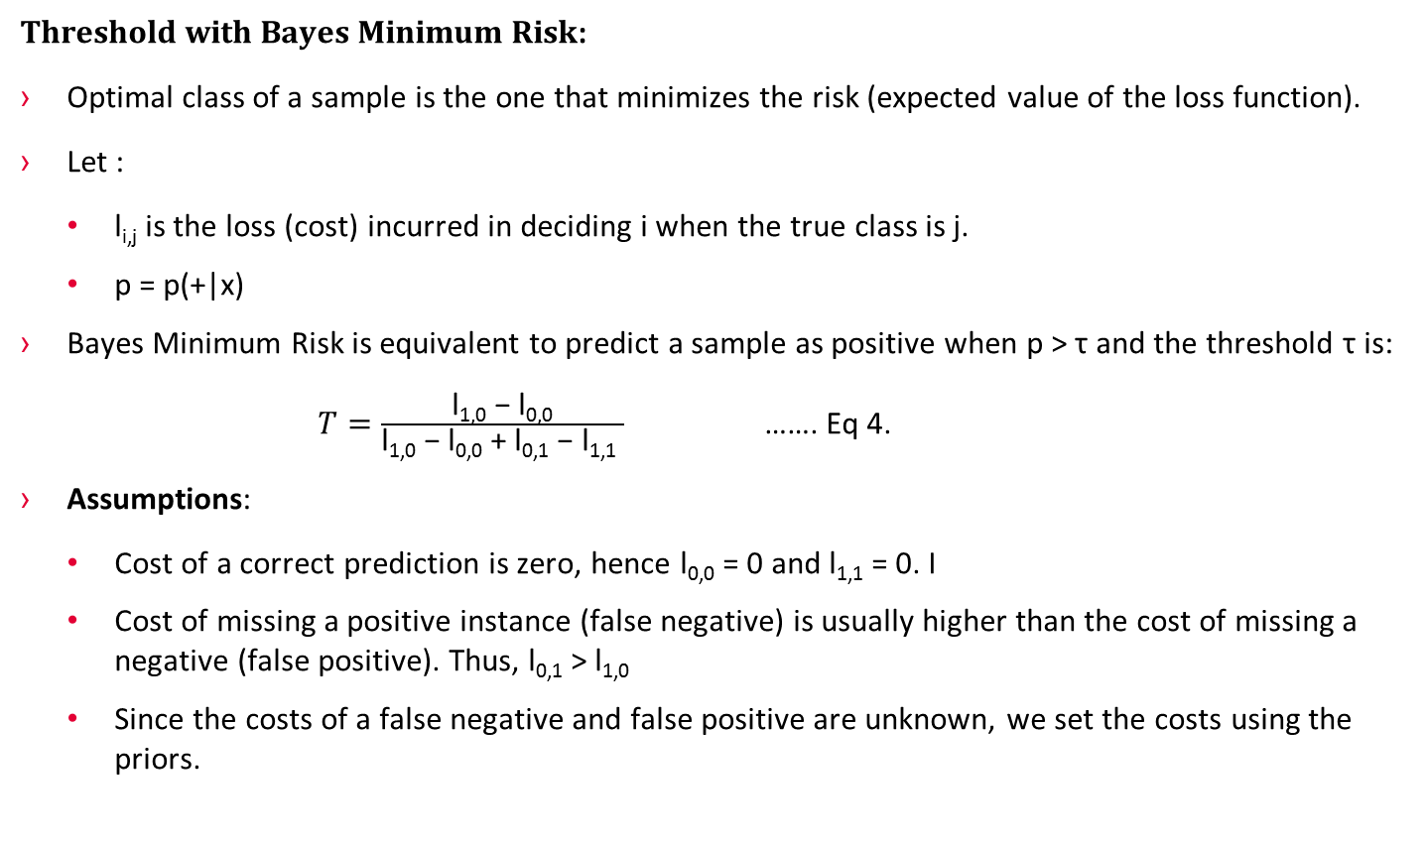
Classification Threshold Adjustment with calibrated probabilities.
Threshold with Bayes Minimum Risk:
Optimal class of a sample is the one that minimizes the risk (expected value of the loss function).
Let :
l_{i,j} is the loss (cost) incurred in deciding i when the true class is j.
p = p(+|x)
Bayes Minimum Risk is equivalent to predict a sample as positive when p > τ and the threshold τ is:
$T=\frac{\text{l}\text{1,0}\text{ − }\text{l}\text{0,0}}{\text{l}\text{1,0}\text{ − }\text{l}\text{0,0}\text{ + }\text{l}\text{0,1}\text{ − }\text{l}\text{1,1} }$ ……. Eq 4.
Assumptions:
Cost of a correct prediction is zero, hence l_{0,0} = 0 and l_{1,1} = 0. I
Cost of missing a positive instance (false negative) is usually higher than the cost of missing a negative (false positive). Thus, l_{0,1} > l_{1,0}
Since the costs of a false negative and false positive are unknown, we set the costs using the priors.

Slide 13
Classification Threshold Adjustment with calibrated probabilities.
Let T’ be the threshold for the unbiased probability p’.
Given eq4 and the stated assumption, from [7] we can calculate that:
T’ = p(+) … Eq 5.
Steps to Follow for Probability Calibration and Threshold Adjustment:
p’ from p_{s} with (3)
Use T’ as classification threshold. From eq 5.

Slide 14
Results:
Diving the Samples into:
Training Set ( 60%, N⁻=170590, N⁺=294)
Testing Set (40%, N_{t}⁻=113725, N_{t}⁺=198)
Setting β
1(not sampled),
0.015
0.00516,
0.00172(completely balanced)
Adjusting Threshold, T – P(+) = 0.00172

Slide 15
Results
 | β = 1 | β = 0.015 | β = 0.00516 | β = 0.00172 | 3 Layer Neural Network
False Negative (FN) | 45 | 29 | 22 | 25 | 56
False Positive(FP) | 121 | 2516 | 4796 | 7544 | 14
True Negative (TN) | 113602 | 111207 | 108927 | 106179 | 113709
True Positive (TP) | 155 | 171 | 178 | 175 | 144
Accuracy | 0. 9985428755 | 0.9776603495 | 0.9577082766 | 0.9335603873 | 0.9993855499
Classification Error Rate | 0.0014571245 | 0.0223396504 | 0.0422917233 | 0.0664396127 | 0.0006144501
Precision | 0.5615942029 | 0.0636397469 | 0.0357860876 | 0.0226713304 | 0.9113924051
Sensitivity (TPR) | 0.775 | 0.855 | 0.89 | 0.875 | 0.72
Specificity (TNR) | 0.9989360112 | 0.9778760673 | 0.9578273524 | 0.933663375 | 0.9998768939
AUC | 0.96 | 0.961 | 0.96815 | 0.95595 | 0.96003
Best performing after probability calibration and threshold adjustment
Increased Sensitivity
Decrease in False Negative (FN)

Slide 16
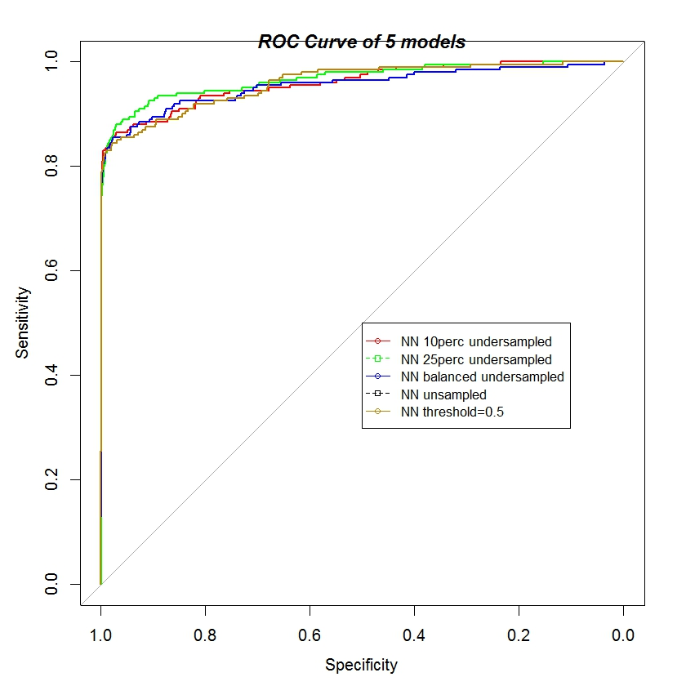
Results:

Slide 17
Future Works:
Comparing the Results with other Algorithmic Level Methods: like SVN.
Implementation of Ensemble method with undersampling, i.e. RusBoost algorithm. Studies have shown RUSBoost works well with unbalanced data. To compare the results.
Working on Strategies for Challenges 2 and 3, i.e. Concept Drift and Verification Latencies.

Slide 18
References:
[1] Krishna M Gopinathan, Louis S Biafore, William M Ferguson, Michael A Lazarus, Anu K Pathria, and Allen Jost. Fraud detection using predictive modeling, October 6 1998. US Patent 5,819,226.
[2] J.R. Dorronsoro, F. Ginel, C. Sgnchez, and CS Cruz. Neural fraud detection in credit card operations. Neural Networks, 8(4):827–834, 1997.
[3] Sushmito Ghosh and Douglas L Reilly. Credit card fraud detection with a neural network. In System Sciences, 1994. Proceedings of the Twenty-Seventh Hawaii International Conference on, volume 3, pages 621–630. IEEE, 1994.
[4] Emin Aleskerov, Bernd Freisleben, and Bharat Rao. Cardwatch: A neural network based database mining system for credit card fraud detection. In Computational Intelligence for Financial Engineering (CIFEr), 1997., Proceedings of the IEEE/IAFE 1997, pages 220–226. IEEE, 1997.
[5] B Fryer. Visa cracks down on fraud. InformationWeek, 594:87, 1996.
[6] Marco Saerens, Patrice Latinne, and Christine Decaestecker. Adjusting the outputs of a classifier to new a priori probabilities: a simple procedure. Neural computation, 14(1):21–41, 2002.
[7] C. Elkan. The foundations of cost-sensitive learning. In International Joint Conference on Artificial Intelligence, volume 17, pages 973–978. Citeseer, 2001.
[8] Andrea Dal Pozzolo, Olivier Caelen, Reid A. Johnson and Gianluca Bontempi. Calibrating Probability with Undersampling for Unbalanced Classification. In Symposium on Computational Intelligence and Data Mining (CIDM). IEEE, 2015.

